Slide 2
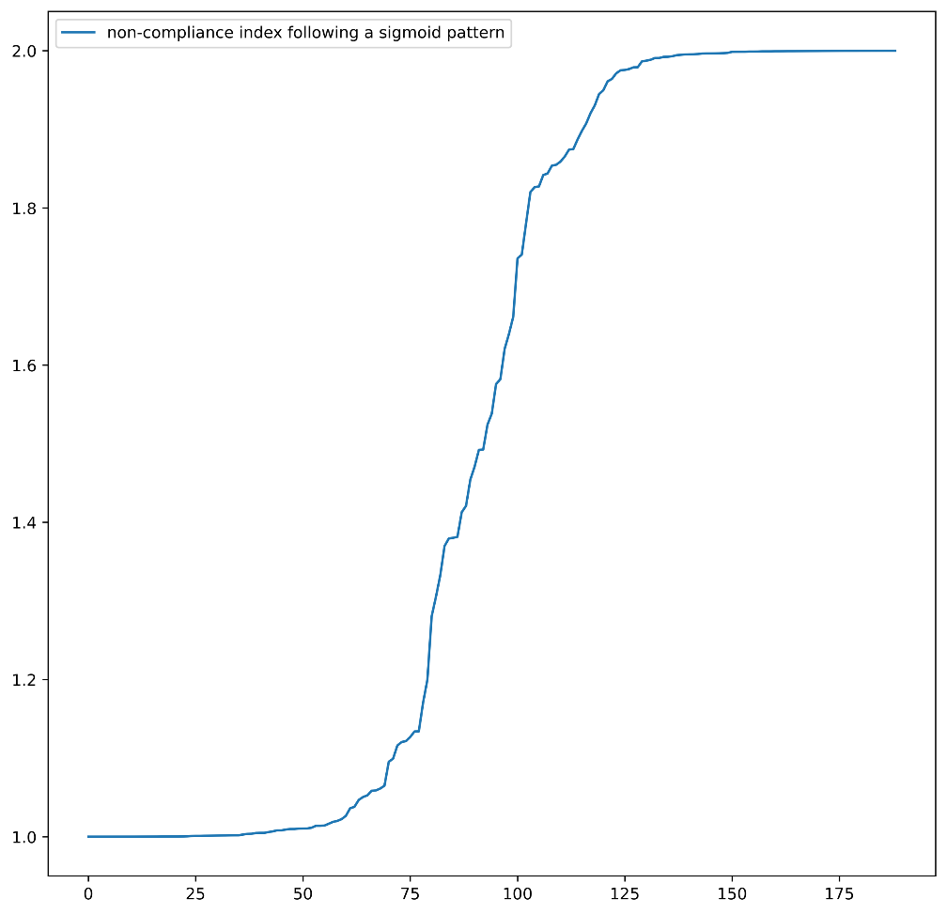
敏感度分析 Sensitivity Analysis
Fig. Sigmoid Model Demonstration Why Sigmoid?

Slide 3
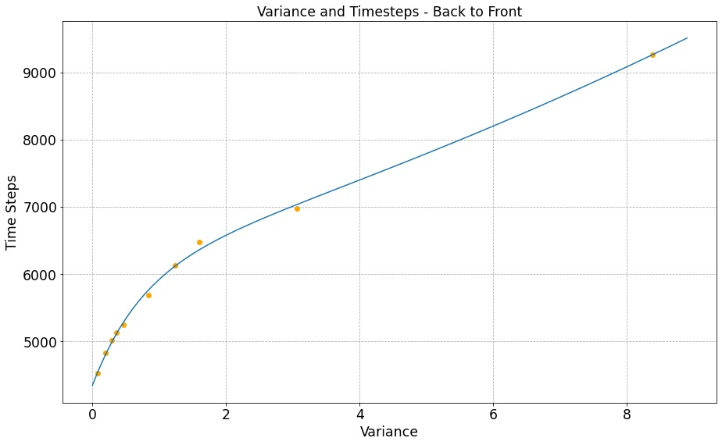
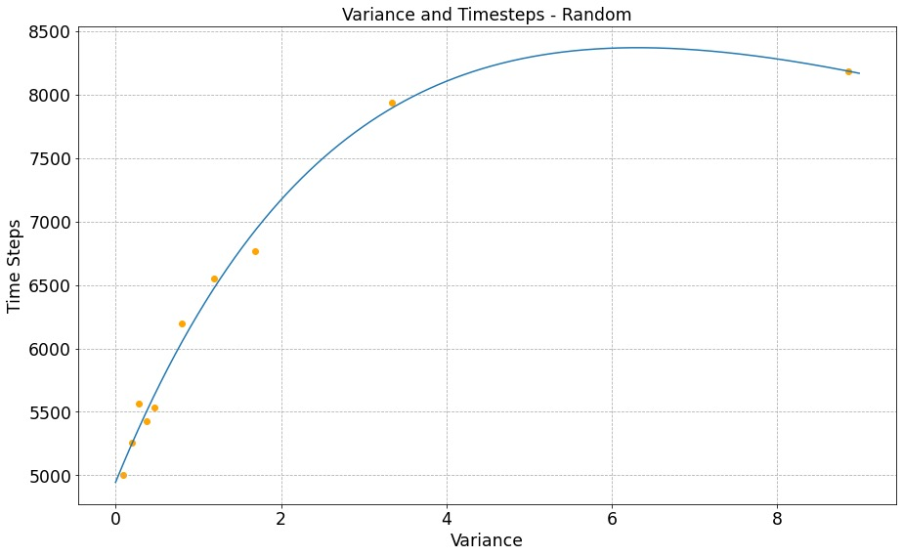
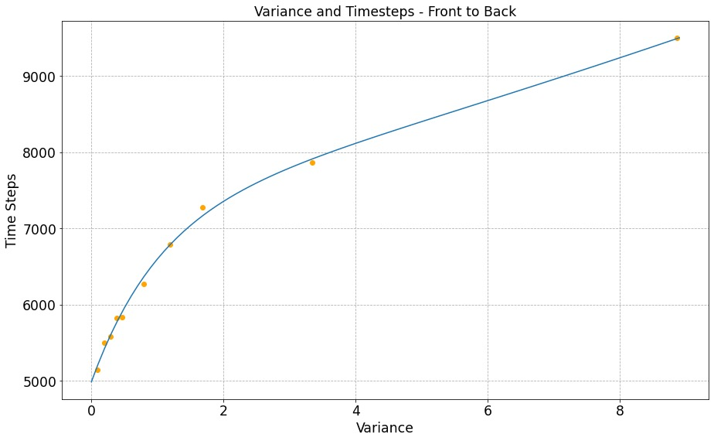
敏感度分析 Sensitivity Analysis
Case 1: A Longer Stowing Time
Fig. Comparison on Longer Stowing Time, Variance

Slide 4
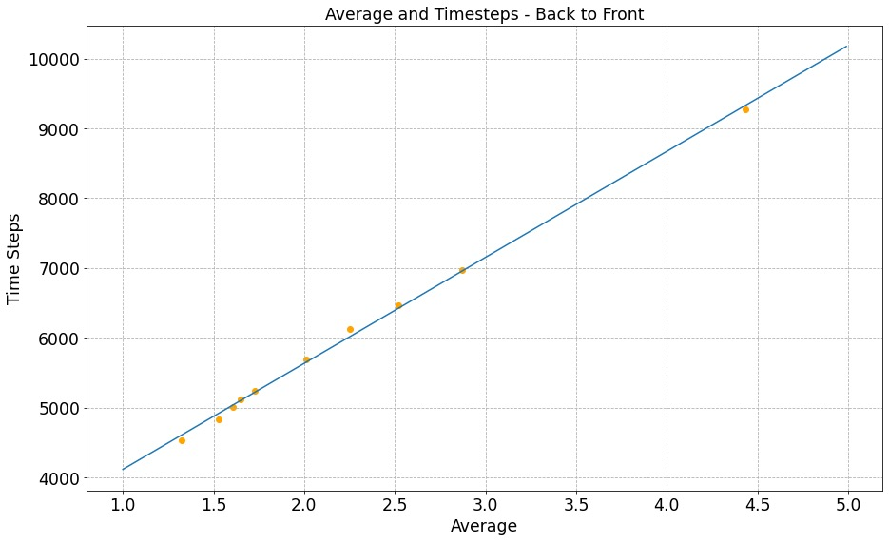
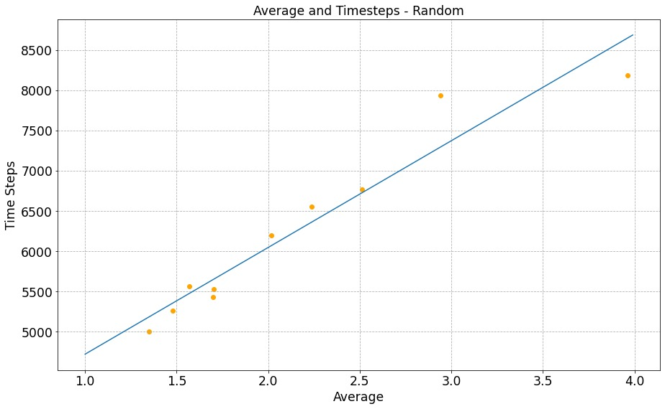
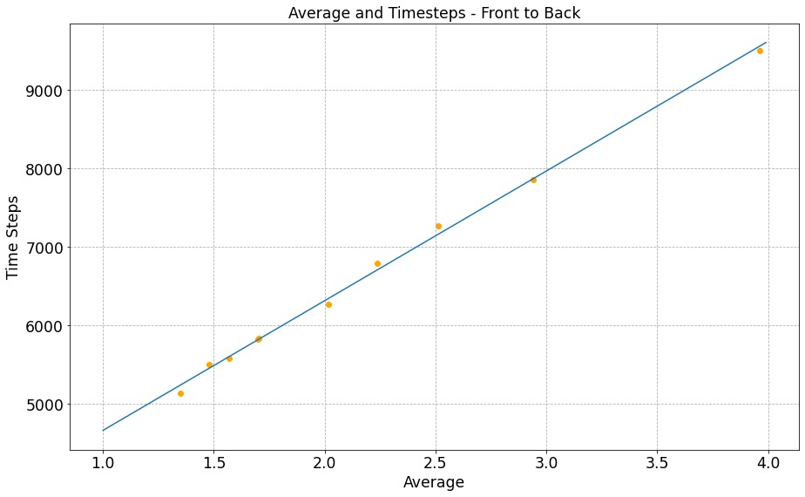
敏感度分析 Sensitivity Analysis
Case 1: A Longer Stowing Time
Random boarding is the most sensitive while Front-to-Back method seems totally not sensitive
Fig. Comparison on Longer Stowing Time, Overall Time

Slide 5
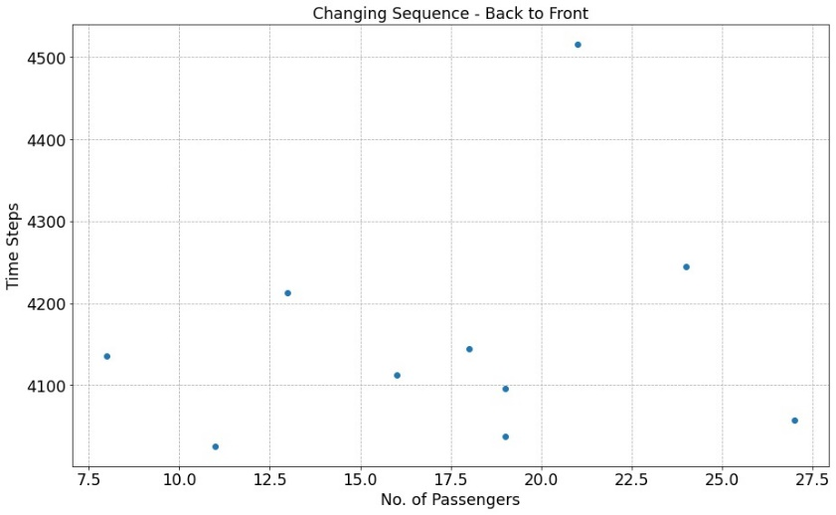
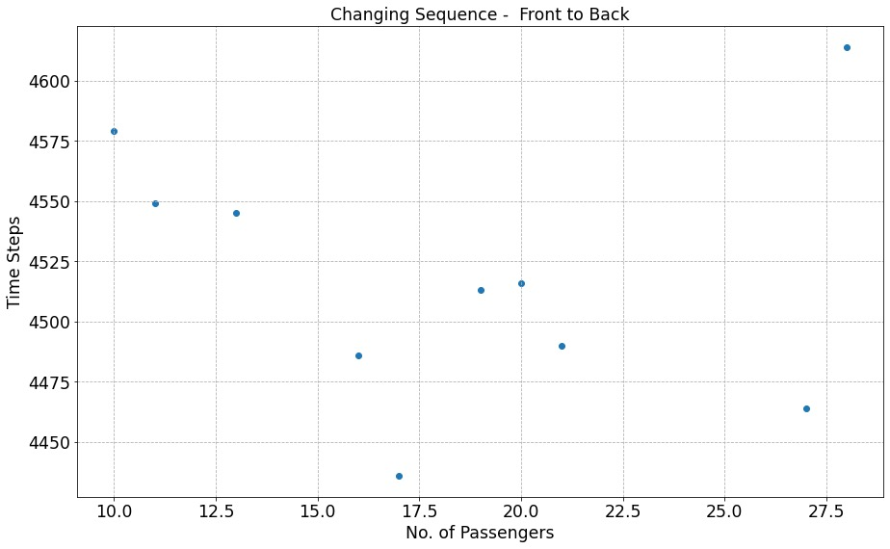
敏感度分析 Sensitivity Analysis
Case 2: Queue Jumping
Both Methods are Sensitive which makes a Big Impact on Total Results
Fig. Comparison on Queue Jumping

